Slide 1
Machine Learning
Lesson 3: Supervised Learning

Slide 2

Types of Supervised Learning
Various Regression Algorithms
Advanced Regularization Techniques
Logistic Regression
Accuracy Metrics

Slide 3
By the end of this lesson, you will be able to:
Understand the different types of supervised learning
Build various regression models

Slide 4
Supervised Learning
Topic 1: Overview

Slide 5

Supervised Learning
Supervised Learning is a type of machine learning used to train models from labeled training data. It allows you to predict output for future or unseen data.
Notes:
Trainer Notes:
Explain using a sample dataset in Excel

Slide 6

Examples of Supervised Learning
Example 1: Weather Apps
The predictions made by weather apps at a given time are based on prior knowledge and analysis of weather over a period of time for a particular place.
Notes:
Trainer Notes:
Give more real time examples

Slide 7
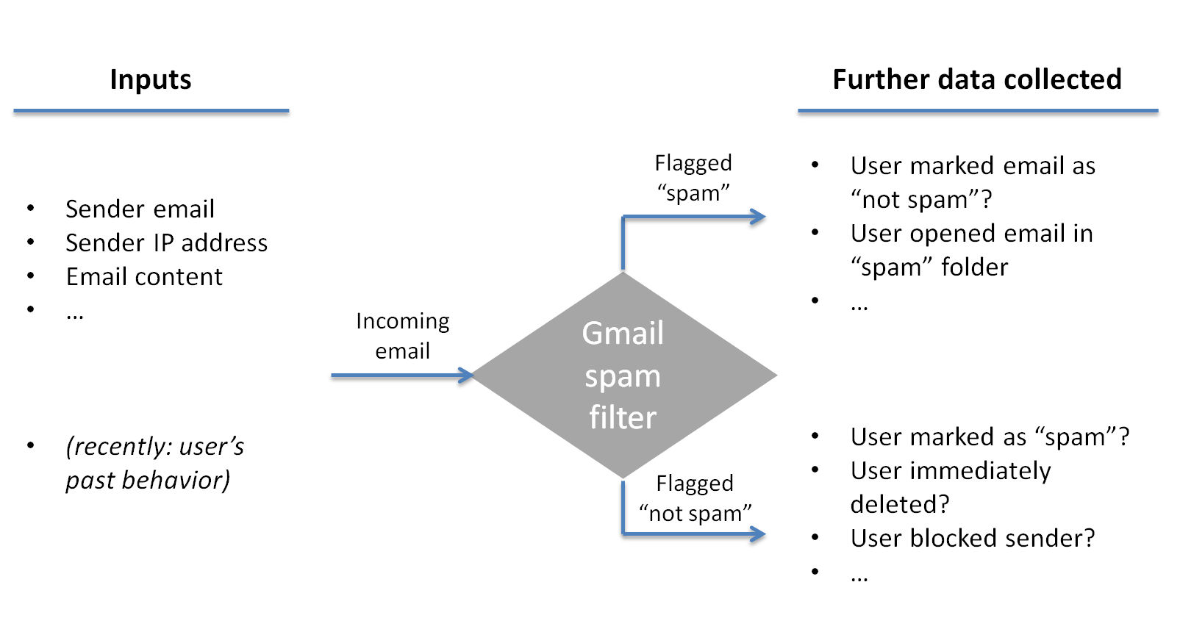
Examples of Supervised Learning (Contd.)
Example 2: Gmail Filters
Gmail filters, a new email into Inbox (normal) or Junk folder (Spam) based on past information of spam.
Notes:
Trainer Notes:
Give more examples

Slide 8


Real-Life Scenario
Ever wondered how Netflix makes recommendations?

Slide 9

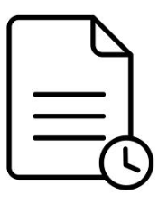
Supervised Learning: Case Study
Netflix uses supervised learning algorithms to recommend users the shows they may watch based on the viewing history and ratings by similar classes of users
New Input
Predicted Outcome
Algorithm Trained on Historical Data
Notes:
Trainer Notes:
Other Examples
Amazon.com - product recommendations
Housing.com - price predictions
Gmail Spam filter

Slide 10
Understanding the Algorithm
Input
Output (Labels)
x1
y1
Train the algorithm (reverse-engineer the relationship between x and y)
x2
y2
x3
y3
Learned algorithm
x4
y4
y = f(x)
(y is some function of x)
Training Data
x5
y5
x6
y6
x7
y7
Predict y for the new instance x_{new} using y = f(x)
x8
y8
x9
y9
x10
y10
Notes:
Trainer Notes:
Explain using a sample dataset

Slide 11




Supervised Learning Flow
$$f\left(x\right)$$
Training and Testing
70%
Training
Dataset
Machine
Learning
Statistical
Model
Historical
Data
Random Sampling
Prediction
30%
Test
Dataset
Prediction and Testing
Model Validation Outcome
Notes:
Trainer Notes:
Show a sample jupyter notebook with the entire process flow after explaining the diagram

Slide 12


Supervised Learning Flow
Use the learned algorithm y = f(x) to predict production data
Training and Testing
$$f\left(x\right)$$
New Data
Model
Prediction Outcome
Prediction
Algorithm prediction can be improved by more training data, capacity, or algorithm redesign.
Notes:
Trainer Notes:
Show a sample jupyter notebook with the entire process flow after explaining the diagram

Slide 13
Supervised Learning
Topic 2: Types of Supervised Learning

Slide 14
Types of Supervised Learning
Classification
1
Supervised Learning
2
Regression
In supervised learning, algorithm is selected based on target variable.

Slide 15


Types of Supervised Learning (Contd.)
If target variable is categorical (classes), then use classification algorithm.
Classification
In other words, classification is applied when the output has finite and discreet values.
Example: Predict the class of car given its features like horsepower,
mileage, weight, colour, etc.
The classifier will build its attributes based on these features.
Analysis has three potential outcomes - Sedan, SUV, or Hatchback
motion
Notes:
Trainer Notes:
Show a sample jupyter notebook/excel file with categorical variable

Slide 16

Types of Supervised Learning (Contd.)
If target variable is a continuous numeric variable (100–2000), then use a regression algorithm.
Example: Predict the price of a house given its sq. area, location, no of bedrooms, etc.
Regression
A simple regression algorithm is given below
y = w * x + b
This shows relationship between price (y) and sq. area (x) where price is a number from a defined range.
Notes:
Trainer Notes:
Show a sample jupyter notebook/excel file with numerical variables

Slide 17
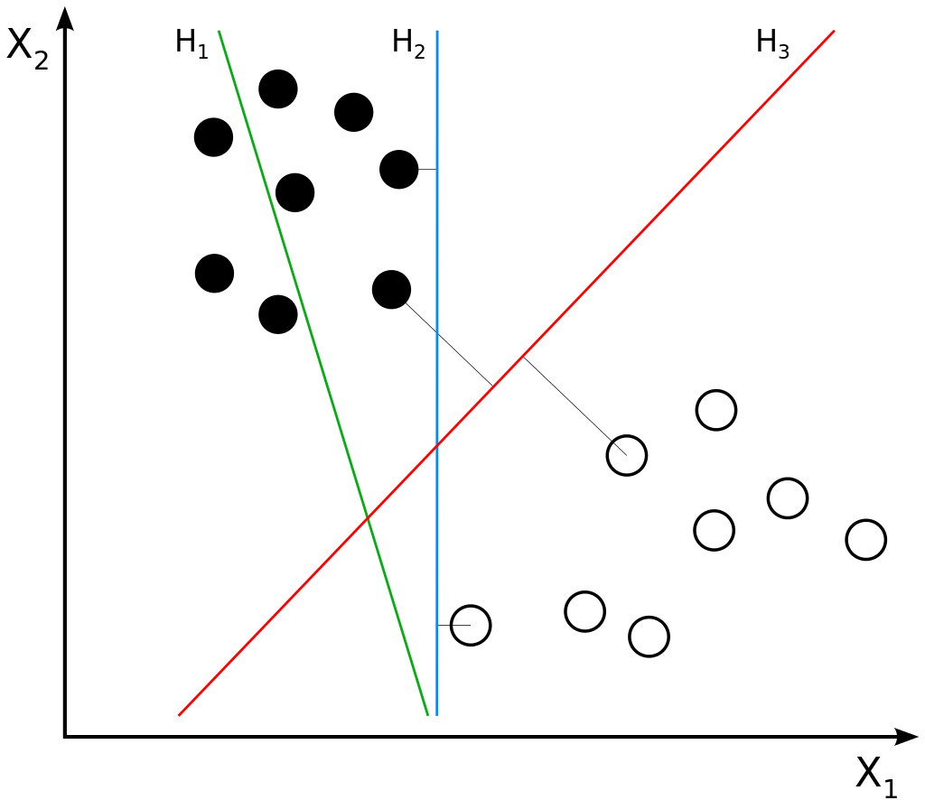

Types of Supervised Learning (Contd.)
Classification
Regression
What Class ?
How much ?
Notes:
Trainer Notes:
Explain the graphs

Slide 18
Types of Classification Algorithms
Logistic Regression
Used to estimate discrete values (binary values like 0/1, yes/no, true/false ) based on given set of independent variable(s)
Decision Trees
Decision Trees make sequential, hierarchical decisions about the outcome variable based on the predictor data
Random Forest
Random Forest is an ensemble of decision trees. It gives better prediction and accuracy than decision tree
Naive Bayes Classifier
Based on Bayes theorem and works with an assumption that features are independent
Support Vector Machines
SVM draws hyperplane in a feature space that separates instances into different categories with margins in between as far apart as possible

Slide 19
Supervised Learning
Topic 3: Types of Regression Algorithms

Slide 20

Types of regression algorithms
Linear
Multiple Linear
Ridge
Lasso
Polynomial
ElasticNet

Slide 21
Types of Regression Algorithms
Linear Regression is a statistical model used to predict the relationship between independent and dependent variables denoted by x and y respectively
Linear Regression
Examine 2 factors
Multiple Linear Regression
1
2
Polynomial Regression
How closely are x and y related ?
Linear regression gives a number
between -1 and 1 indicating
the strength of correlation
between the two variables
0 : no correlation
1 : positively correlated
-1 : negatively correlated
Prediction
When the relationship between x and y is known, use this to predict
future values of y for a value of x
This is done by fitting a regression line and represented by a
linear equation:
y = a * x + b
Ridge Regression
Lasso
Regression
ElasticNet Regression
Notes:
Trainer Notes:
Explain the correlation matrix

Slide 22
Types of Regression Algorithms (Contd.)
Linear Regression
Multiple linear regression is a statistical technique used to predict the outcome of a response variable through several explanatory variables and model the relationships between them.
Multiple Linear Regression
.
.
y
Polynomial Regression
Equation for MLR
.
.
.
.
.
Y = m₁* x₁ + m₂* x₂ + m₃* x₃ + ………+ m_{n}* x_{n} + c
x₂
.
.
.
.
.
Ridge Regression
.
.
.
m1, m2, m3 …. m_{n}
.
Lasso
Regression
Dependent Variable
Coefficient
x₁
Slopes
ElasticNet Regression
Notes:
Trainer Notes:
Explain when MLR is used

Slide 23
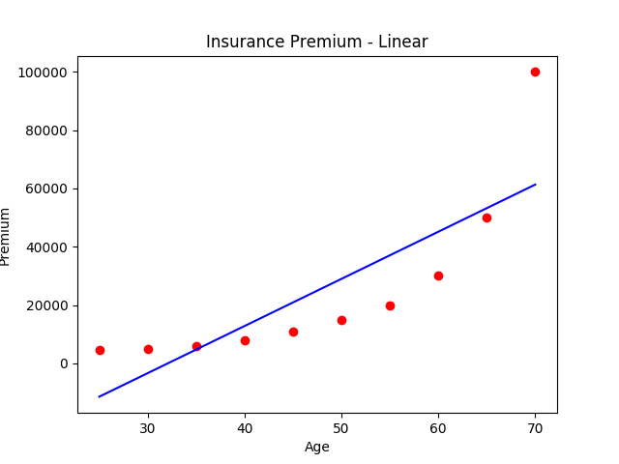
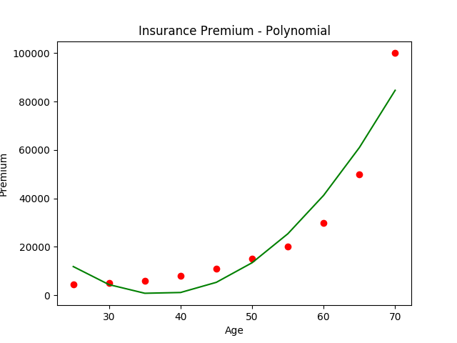
Types of Regression Algorithms (Contd.)
Linear Regression
Polynomial regression is applied when data is not formed in a straight line.
It is used to fit a linear model to non-linear data by creating new features from powers of non-linear features.
Example: Quadratic features
Multiple Linear Regression
x₂’ = x₂²
y = w₁x₁ + w₂x₂² + 6
= w₁x₁ + w₂x₂’ + 6
Polynomial Regression
Ridge Regression
Lasso
Regression
Better fit
ElasticNet Regression
Notes:
Trainer Notes:
Explain when to use polynomial regression

Slide 24




Regression Use Case
Predicting profit based on expenditures of the company
Administration
2
1
R&D Spend
Marketing Spend
3
Profit Estimation
5
Profit
4
State

Slide 25
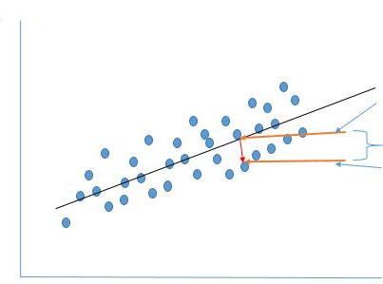
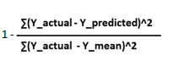
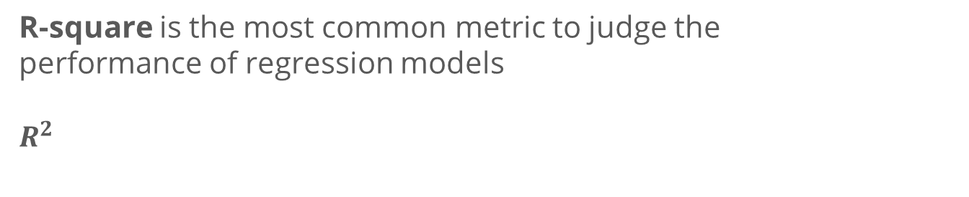
Accuracy Metrics
Predicted Value
Error
R-square =
Actual Value
R-square is the most common metric to judge the performance of regression models
$$R^{2}$$
lies between 0 -100 %
Example: Performing linear regression on sq. Area (x) and Price (y) returns R-square value as 16 This means you have 16% information to make an accurate prediction about the price.
Notes:
Trainer Notes:
Show a sample jupyter notebook with the accuracy metrics

Slide 26
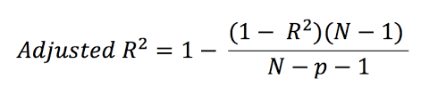
Adjusted R-Squared
The disadvantage with R-squared is that it assumes every independent variable in the model explains variations in the dependent variable.
Use adjusted R-squared when working on a multiple linear regression problem.
where R² is R-squared value
P is number of predictor variables
N is number data points
Notes:
Trainer Notes:
Explain when to use Adjusted R-squared

Slide 27
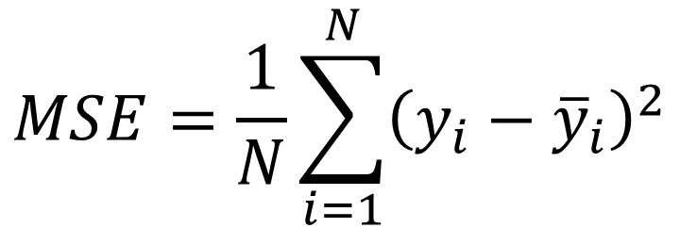
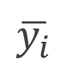
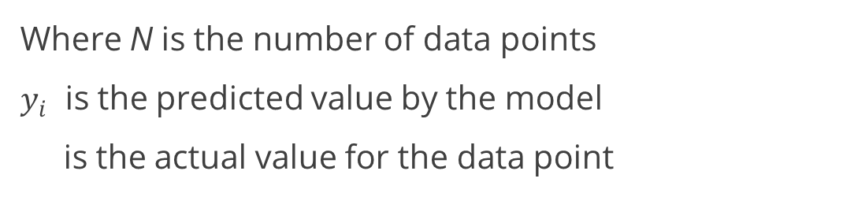
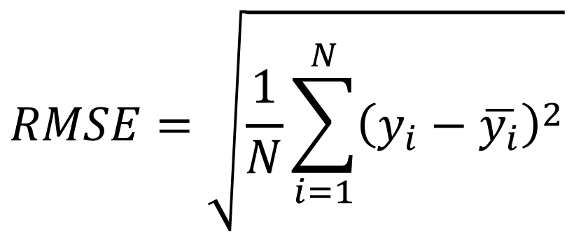
Cost Function
Mean-Squared Error (MSE) is also used to measure the performance of a model.
$$RMSE=\sqrt{\frac{1}{N}\sum_{i=1}^{N}{{\left(y_{i}−\overline{y_{i}}\right)}^{2}}}$$
$$MSE=\frac{1}{N}\sum_{i=1}^{N}{{\left(y_{i}−{\overline{y}}_{i}\right)}^{2}}$$
Where N is the number of data points
$y_{i}$ is the predicted value by the model
is the actual value for the data point
$$\overline{y_{i}}$$
These functions are called the loss function or the cost function, and the value has to be minimized.
Notes:
Trainer Notes:
Show a sample Jupyter notebook with the cost function

Slide 28
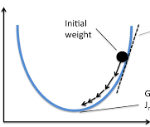
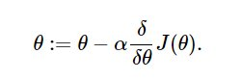
Gradient Descent
Gradient descent is another algorithm used to reduce the loss function.
It is an optimization algorithm that tweaks it’s parameters (coefficients) iteratively to minimize a given cost function to its minimum.
Model stops learning when the gradient (slope) is zero
1) Initialize parameter by some value
2) For each iteration calculate the derivative of the cost function and simultaneously update the parameters until a global minimum
Algorithm :
Gradient
Minimum
Random initial Value
where ἀ is the learning rate
Notes:
Trainer Notes:
Demo this using Jupyter notebook

Slide 29
Evaluating Coefficients
In regression analysis, p-values and coefficients together indicate which relationships in the model are statistically significant and the nature of those relationships.
Coefficients describe the mathematical relationship between each independent variable and the dependent variable.
p-values for the coefficients indicate whether these relationships are statistically significant.
p < 0.05
REJECT the Null hypothesis, meaning variables have some effect and need to be retained
p > 0.05
ACCEPT the Null hypothesis, meaning variables have no effect and can be removed

Slide 30
Assisted Practice
Regression
Duration: 20 mins.
Problem Statement: The Advertising dataset captures sales revenue generated with respect to advertisement spends across multiple channels like radio, tv, and newspaper.
Objective:
Build a linear regression model to:
Interpret the coefficients of the model
Make predictions
Find and analyze model residuals
Evaluate model efficiency using RMSE and R-Square values
Access: Click on the Labs tab on the left side panel of the LMS. Copy or note the username and password that are generated. Click on the Launch Lab button. On the page that appears, enter the username and password in the respective fields, and click Login.
Notes:
Trainer Notes:
Perform the above demo in python by downloading Advertising.csv file and explain the functioning of each step
Also, ask the learner to perform the demo simultaneously on their system

Slide 31
Unassisted Practice
Regression
Duration: 20 mins.
Problem Statement: A real estate company wants to build homes at different locations in Boston.
They have data for historical prices but haven’t decided the actual prices yet. They want to price it so that it is affordable to the general public.
Objective:
Import the Boston data from sklearn and read the description using DESCR
Analyze the data and predict the approximate prices for the houses
Access: Click on the Labs tab on the left side panel of the LMS. Copy or note the username and password that are generated. Click on the Launch Lab button. On the page that appears, enter the username and password in the respective fields, and click Login.
Notes:
Trainer Notes:
1. Learners should code on their own.
2. You can assist learners if they face any errors or do not understand any part of the question
3. Solution is provided in the next slide

Slide 32
Answer
Code
Importing libraries
import numpy as np
import pandas as pd
import matplotlib.pyplot as plt
%matplotlib inline
Importing Dataset
from sklearn.datasets import load_boston
boston = load_boston()
boston.keys()
boston.feature_names
boston.target
print(boston.DESCR)
df = pd.DataFrame(boston.data)
df.shape

Slide 33
Answer (Contd.)
Code
Creating train and test dataset
x_train = df.drop(['HOUSING_VALUE'], axis=1)
y_train = df['HOUSING_VALUE’]
xtrain,xtest,ytrain,ytest = model_selection.train_test_split(x_train,y_train,test_size=0.3,random_state=42)
Model Building
from sklearn.linear_model import LinearRegression
model = LinearRegression(n_jobs = -1)
model.fit(xtrain,ytrain)
print(model.intercept_)
print(model.coef_)
print(df.columns.values.tolist())
list(zip(df.columns,model.coef_))
Notes:
Trainer notes:
Explain why we use LinearRegression(n_jobs = -1)

Slide 34
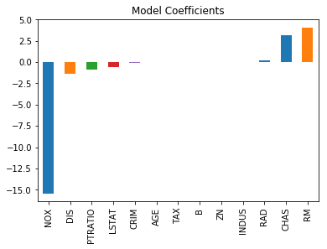
Answer (Contd.)
Code
Checking the magnitude of coefficients
predictors = df.columns[:-1]
coef = pd.Series(model.coef_,predictors).sort_values()
coef.plot(kind='bar', title='Modal Coefficients’)
plt.scatter(df.RM,df.HOUSING_VALUE)
plt.title("Relationship between RM and Target Variable")
plt.show()
plt.scatter(df.NOX,df.HOUSING_VALUE)
plt.title("Relationship between NOX and Target Variable")
plt.show()
print('R2 Value/Coefficient of Determination: {}'.format(model.score(xtest, ytest)))

Slide 35
Answer (Contd.)
Code
Final prediction
plt.scatter(ytrain,model.predict(xtrain))
print(sqrt(mean_squared_error(ytrain, model.predict(xtrain))))
plt.scatter(ytest,model.predict(xtest))
print(sqrt(mean_squared_error(ytest, model.predict(xtest))))
pd.DataFrame({'Actual': ytest, 'Predicted': model.predict(xtest)}).head(10)

Slide 36
Challenges in Prediction
X
X
o
X
o
o
o
o
o
o
o
o
o
X
o
o
X
X
X
o
X
o
X
o
X
X
X
o
X
X
o
X
o
o
o
X
o
X
X
X
X
X
o
X
o
X
X
o
X
Under Fit
Appropriate
Over Fit
If the model learning is poor, you have an underfitted situation
The algorithm will not work well on test data Retraining may be needed to find a better fit
Overfitting happens when model accuracy
for training data is good, but model does not
generalize well to the overall population
Algorithm is not able to give good predictions
for the new data
Notes:
Trainer Notes:
Explain model performance using jupyter notebook

Slide 37
Regularization
Regularization solves overfitting to the training data.
Used to restrict the parameters values that are estimated in the model
Training
L = ∑( Ŷ_{i}– Y_{i})² + λ ∑ β²
Testing
This loss function includes 2 elements.
1) the sum of square distances between predicted and actual value
2) the second element is the regularization term
Notes:
Trainer notes:
1. Talk about Overfitting
2. Show the code on how regularization solves overfitting of data

Slide 38
Types of Regression (Contd.)
Linear Regression
Ridge Regression (L2) is used when there is a problem of multicollinearity.
By adding a degree of bias to the regression estimates, ridge regression reduces the standard errors.
Multiple Linear Regression
Polynomial Regression
The main idea is to find a new line that has some bias with respect to the training data
In return for that small amount of bias, a significant drop in variance is achieved
Ridge Regression
Lasso
Regression
Minimization objective = LS Obj + λ * (sum of the square of coefficients)
LS Obj refers to least squares objective
λ controls the strength of the penalty term
ElasticNet Regression
Notes:
Trainer notes: Explain the following
Model performance using ridge
Alpha (hyperparameter of ridge)
When to use Ridge

Slide 39
Types of Regression (Contd.)
Linear Regression
Lasso Regression (L1) is similar to ridge, but it also performs feature selection.
Multiple Linear Regression
It will set the coefficient value for features that do not help in decision making very low, potentially zero.
Polynomial Regression
Minimization objective = LS Obj + λ * (sum of absolute coefficient values)
Ridge Regression
Lasso regression tends to exclude variables that are not required from the equation, whereas ridge tends to do better when all variables are present.
Lasso
Regression
ElasticNet Regression
Notes:
Trainer notes: Explain the following
Model performance using Lasso
Alpha (hyperparameter of Lasso)
When to use Lasso (shortcomings)

Slide 40
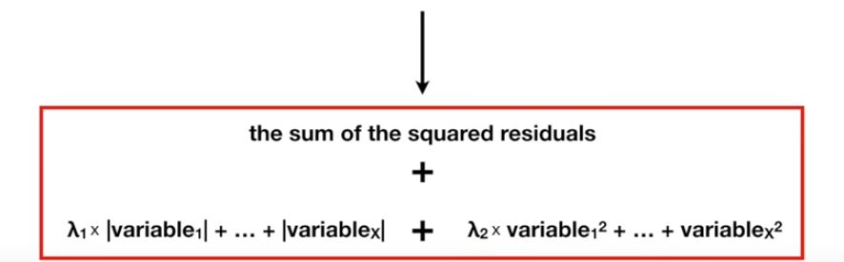
Types of Regression (Contd.)
Linear Regression
ElasticNet regression combines the strength of lasso and ridge regression
Multiple Linear Regression
Polynomial Regression
Ridge Regression
Lasso
Regression
Lasso penalty
Ridge penalty
If you are not sure whether to use lasso or ridge, use ElasticNet
ElasticNet Regression
Notes:
Trainer notes: Explain the following
Model performance using ridge
Alpha (hyperparameter of ridge)
When to use Ridge, Lasso or ElasticNet

Slide 41
Assisted Practice
Regression
Duration: 20 mins.
Problem Statement: BigMart has collected sales data for 1559 products across 10 stores in different cities. Attributes of each product and store have been defined.
Objective:
Build a predictive model and find out the sales of each product at a particular store
Using Ridge and Lasso regression techniques, interpret the coefficients of the model
Make predictions using the model
Evaluate model efficiency using RMSE and R-Square values
Access: Click on the Labs tab on the left side panel of the LMS. Copy or note the username and password that are generated. Click on the Launch Lab button. On the page that appears, enter the username and password in the respective fields, and click Login.
Notes:
Trainer Notes:
Perform the above demo in python by downloading bigmart_train.csv file and explain the functioning of each step
Also, ask the learner to perform the demo simultaneously on their system

Slide 42
Unassisted Practice
Regression
Duration: 10 mins.
Problem Statement: For the Boston dataset used earlier, the team also wants to cross-reference results using regularization techniques
Objective:
Build a predictive model using Ridge, Lasso and ElasticNet
Compare the models basis on accuracy
Access: Click on the Labs tab on the left side panel of the LMS. Copy or note the username and password that are generated. Click on the Launch Lab button. On the page that appears, enter the username and password in the respective fields, and click Login.
Notes:
Trainer Notes:
1. Learners should code on their own.
2. You can assist learners if they face any errors or do not understand any part of the question
3. Solution is provided in the next slide

Slide 43
Answer
Code
Ridge
from sklearn.linear_model import Ridge
ridgeReg = Ridge(alpha=0.001, normalize=True)
ridgeReg.fit(xtrain,ytrain)
print(sqrt(mean_squared_error(ytrain, ridgeReg.predict(xtrain))))
print(sqrt(mean_squared_error(ytest, ridgeReg.predict(xtest))))
print('R2 Value/Coefficient of Determination: {}'.format(ridgeReg.score(xtest, ytest)))
Lasso
from sklearn.linear_model import Lasso
lassoreg = Lasso(alpha=0.001, normalize=True)
Lasso.fit(xtrain,ytrain)
print(sqrt(mean_squared_error(ytrain, Lasso.predict(xtrain))))
print(sqrt(mean_squared_error(ytest, Lasso.predict(xtest))))
print('R2 Value/Coefficient of Determination: {}'.format(Lasso.score(xtest, ytest)))
Notes:
Trainer notes:
explain Ridge(alpha=0.001, normalize=True) and Lasso(alpha=0.001, normalize=True)

Slide 44
Answer (Contd.)
Code
ElasticNet
from sklearn.linear_model import ElasticNet
Elastic = ElasticNet(alpha=0.001, normalize=True)
Elastic.fit(xtrain,ytrain)
print(sqrt(mean_squared_error(ytrain, Elastic.predict(xtrain))))
print(sqrt(mean_squared_error(ytest, Elastic.predict(xtest))))
print('R2 Value/Coefficient of Determination: {}'.format(Elastic.score(xtest, ytest)))
Notes:
Trainer notes:
explain ElasticNet(alpha=0.001, normalize=True)

Slide 45
Supervised Learning
Topic 4: Logistic Regression

Slide 46
Logistic Regression
1.00
Logistic Regression is widely used to predict binary outcomes for a given set of independent variables.
The dependent variable’s outcome is discrete such as y ϵ {0, 1}
0.80
0.60
Probability of passing exam
A binary dependent variable can have only two values such as 0 or 1, win or lose, pass or fail, healthy or sick.
0.40
0.20
1
2
3
4
5
6
Hours studied
Notes:
Trainer Notes: Explain the following
1. When to use Logistic regression
2. Is Multicollinearity a problem in logistic regression?

Slide 47


Use Cases
Loan sanction
Customer segments
Spam
Spam
Spam
Spam Filter
Spam filtering
Exam results – Pass/Fail

Slide 48

Real-Life Scenarios
Malignant
1
Benign
0
Weather Forecast
sunny, stormy, cloudy, rainy
Cancer Prediction
Malignant (cancerous) and Benign (non-cancerous)
Notes:
Trainer Notes:
1. Give more real life scenarios

Slide 49
Logistic Regression (Contd.)
Probability > 0.50 Value is rounded off to 1
Pass
1.00
The probability distribution of output y is restricted to 1 or 0. This is called as sigmoid probability (σ)
If σ (θTx) > 0.5, set y = 1, else set y = 0.
0.90
0.80
Threshold value 0.50 indicates the likelyhood to pass after 3.5 hours of study
0.60
Unlike Linear Regression ( and its Normal Equation solution ),
there is no closed form solution for finding optimal
weights of Logistic Regression.
Instead, you must solve this with maximum likelihood estimation ( a probability model to detect maximum likelihood of something happening ).
Threshold Value
Probability of passing exam
0.50
0.40
0.29
Probability < 0.50
Value is rounded off to 0 Fail
0.20
1
2
3
4
5
6
Hours studied
Notes:
Trainer Notes: Explain the following
1. MLE concept
2. The graph on the right side

Slide 50
Logistic Regression Equation
The Logistic regression equation is derived from the straight line equation:
Equation of a straight line
Y = bx1 + cx2 + D
Range is from – (infinity) to (infinity)
Deducing the logistic regression equation from straight line equation
Y = bx1 + cx2 + D
In logistic equation, Y can be only from 0 to 1
Transform it to get the range
Y
1-Y
Y= 0 then 0
Y= 1 then infinity
Now, the range is between 0 to infinity
Transform it further to get range: (infinity) to (infinity)
Y
1-Y
log
Final Logistic Regression Equation
Y = bx1 + cx2 + D
Notes:
Trainer Notes:
1. This is for reference purpose

Slide 51
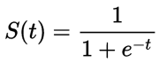
Sigmoid Probability
The probability in the logistic regression is represented by the Sigmoid function (logistic function or the S-curve).
t represents data values * number of hours studied
S(t) represents the probability of passing the exam.
The sigmoid function gives an ‘S’ shaped curve.
This curve has a finite limit that is Y can only be 0 or 1
0 as x approaches to −∞
1 as x approaches to +∞
1.00
0.80
0.60
0.40
0.20
1
2
3
4
5
6
Notes:
Trainer Notes:
1. Explain working of Sigmoid Probability

Slide 52
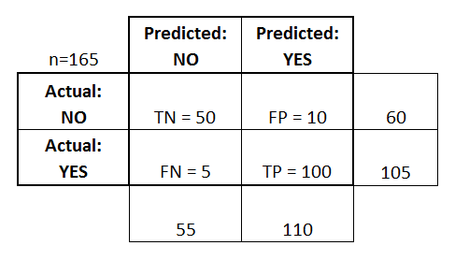
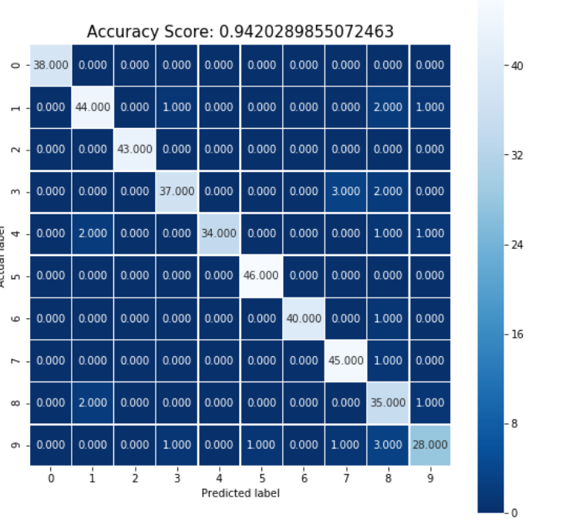
Accuracy Metrics
Accuracy = True Positive (TP) + True Negative (TN)
Total
Confusion Matrix
Confusion Matrix for a multi - class classification
Notes:
Trainer Notes:
1. Explain confusion matrix 2. Demo using Jupyter notebook

Slide 53
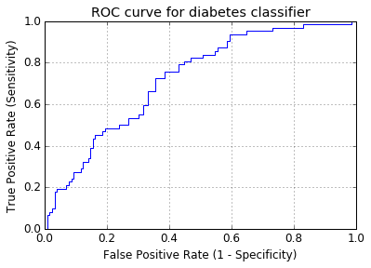
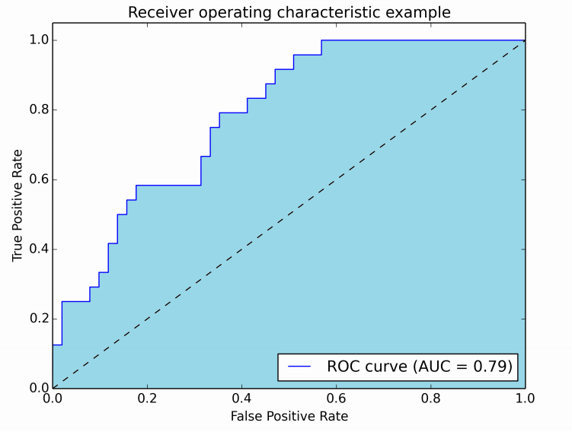
Accuracy Metrics (Contd.)
True Positive Rate
False Positive Rate
ROC curve
Compares the model true positive and false positive rates to the ones from a random assignment
AUC (Area under the ROC Curve)
Measures the entire two-dimensional area under the entire ROC curve
Notes:
Trainer Notes:
1. Explain ROC and AUC and when to use them

Slide 54
Assisted Practice
Regression
Duration: 20 mins.
Problem Statement: The sinking of the Titanic is one of the biggest maritime disaster in the history, killing 1502 out of 2224 passengers and the crew. One of the reasons for such loss was that there were not enough lifeboats. Some groups of people were more likely to survive than others, such as women, children, and the upper-class.
Objective:
Use logistic regression to predict the survival of a given passenger based on features, such as sex, age
Access: Click on the Labs tab on the left side panel of the LMS. Copy or note the username and password that are generated. Click on the Launch Lab button. On the page that appears, enter the username and password in the respective fields, and click Login.
Notes:
Trainer Notes:
Perform the above demo in python by downloading train.csv file and explain the functioning of each step
Also, ask the learner to perform the demo simultaneously on their system

Slide 55
Unassisted Practice
Regression
Duration: 20 mins.
Problem Statement: The Iris plant has 3 species - Iris Setosa, Iris Versicolour, Iris Virginica
One class is linearly separable from the other two; the latter are not linearly separable from each other.
Objective:
Import the iris dataset using sklearn
Use logistic regression to predict the class of iris plant
Access: Click on the Labs tab on the left side panel of the LMS. Copy or note the username and password that are generated. Click on the Launch Lab button. On the page that appears, enter the username and password in the respective fields, and click Login.
Notes:
Trainer Notes:
1. Learners should code on their own.
2. You can assist learners if they face any errors or do not understand any part of the question
3. Solution is provided in the next slide

Slide 56
Answer
Code
Importing the required libraries
from sklearn import datasets
import numpy as np
from sklearn.model_selection import train_test_split
from sklearn.preprocessing import StandardScaler
from sklearn.metrics import accuracy_score
import matplotlib.pyplot as plt
import matplotlib.colors
from sklearn.linear_model import LogisticRegression
Importing the dataset
iris = datasets.load_iris()
X = iris.data[:, [2, 3]]
y = iris.target
print('Class labels:', np.unique(y))

Slide 57
Answer (Contd.)
Code
Train test split
X_train, X_test, y_train, y_test = train_test_split(X, y, test_size=0.3, random_state=1, stratify=y)
print('Labels counts in y:', np.bincount(y))
print('Labels counts in y_train:', np.bincount(y_train))
print('Labels counts in y_test:', np.bincount(y_test))
Standardizing features
sc = StandardScaler()
sc.fit(X_train)
X_train_std = sc.transform(X_train)
X_test_std = sc.transform(X_test)

Slide 58
Answer (Contd.)
Code
Plotting decision surface
def plot_decision_regions(X, y, classifier, test_idx=None, resolution=0.02):
# setup marker generator and color map
markers = ('s', 'x', 'o', '^', 'v')
colors = ('red', 'blue', 'lightgreen', 'gray', 'cyan')
cmap = matplotlib.colors.ListedColormap(colors[:len(np.unique(y))])
# plot the decision surface
x1_min, x1_max = X[:, 0].min() - 1, X[:, 0].max() + 1
x2_min, x2_max = X[:, 1].min() - 1, X[:, 1].max() + 1
xx1, xx2 = np.meshgrid(np.arange(x1_min, x1_max, resolution),np.arange(x2_min, x2_max, resolution))
Z = classifier.predict(np.array([xx1.ravel(), xx2.ravel()]).T)
Z = Z.reshape(xx1.shape)
plt.contourf(xx1, xx2, Z, alpha=0.3, cmap=cmap)
plt.xlim(xx1.min(), xx1.max())
plt.ylim(xx2.min(), xx2.max())

Slide 59
Answer (Contd.)
Code
Plotting decision surface
for idx, cl in enumerate(np.unique(y)):
plt.scatter(x=X[y == cl, 0], y=X[y == cl, 1],alpha=0.8, c=colors[idx],marker=markers[idx], label=cl, edgecolor='black')
if test_idx:
X_test, y_test = X[test_idx, :], y[test_idx]
plt.scatter(X_test[:, 0], X_test[:, 1],c='',edgecolor='black',alpha=1.0,linewidth=1,marker='o',s=100, label='test set')
X_combined_std = np.vstack((X_train_std, X_test_std))
y_combined = np.hstack((y_train, y_test))

Slide 60
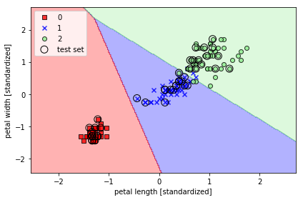
Answer (Contd.)
Output plot

Slide 61
Answer (Contd.)
Code
Training logistic regression model
lr = LogisticRegression(C=100.0, random_state=1)
lr.fit(X_train_std, y_train)
plot_decision_regions(X_combined_std, y_combined,
classifier=lr, test_idx=range(105, 150))
plt.xlabel('petal length [standardized]')
plt.ylabel('petal width [standardized]')
plt.legend(loc='upper left')
plt.tight_layout()
#plt.savefig('images/03_06.png', dpi=300)
plt.show()
lr.predict_proba(X_test_std[:3, :])
lr.predict_proba(X_test_std[:3, :]).sum(axis=1)
lr.predict_proba(X_test_std[:3, :]).argmax(axis=1)
lr.predict(X_test_std[:3, :])
lr.predict(X_test_std[0, :].reshape(1, -1))

Slide 62
Now, you are able to:
Understand the different types of supervised learning
Build various regression models

Slide 63

© Simplilearn. All rights reserved.

Slide 64
In the equation of a straight line Y = mX + c, the term m is the:
1
Slope
Independent Variable
Dependent Variable
Intercept
© Simplilearn. All rights reserved.

Slide 65
In the equation of a straight line Y = mX + c, the term m is the:
1
Slope
Independent Variable
Dependent Variable
Intercept
a. Slope
In the equation of a straight line Y = mX + c, m represents the slope, and c is any constant.

Slide 66
The standard error of the estimate is a measure of:
2
Explained variation
Variation around the regression line
Variation of the X variable
Total variation of the Y variable
© Simplilearn. All rights reserved.

Slide 67
The standard error of the estimate is a measure of:
2
Explained variation
Variation around the regression line
Variation of the X variable
Total variation of the Y variable
b. Variation around the regression line
The standard error of the estimate is a measure of the variation around the regression line.

Slide 68
Lesson-End Project
Health Insurance Cost
Duration: 20 mins.
Problem Statement:
Health insurance has become an indispensable part of our lives in recent years and people are paying for them to cover up losses caused either by accident or other unpredicted factors.
You are provided with medical costs dataset that has features such as Age, Cost, BMI
Objective:
Determine the factors that contribute the most in the calculation of insurance costs
Predict the health Insurance Cost
Access: Click on the Labs tab on the left side panel of the LMS. Copy or note the username and password that are generated. Click on the Launch Lab button. On the page that appears, enter the username and password in the respective fields, and click Login.
Notes:
Trainer Notes: Describe the project to the learners and instruct them to perform it after the lesson.

Slide 69
© Simplilearn. All rights reserved.

